Slide 1
Welcome

Slide 2
Introduction of the teacher
Sumon Paul
Assistant Teacher of Sreemothpur Govt Primary School.
Nabiganj, Habiganj.

Slide 3
Introduction of the lesson
Class : Four
Unit : 15
Lesson : 1-3
Lesson Title : Sagor and his family
Today Lesson : Hai! I’m Sagor………….very smart.
Time : 35 minutes.

Slide 4
Learning outcomes
Listening:
1.1.1 Repeat after the teacher and say words, phrases and sentences with proper sounds, stress and intonation.
3.2.1 Understand the questions about the family and friends of students.
Speaking:
3.2.1 Understand questions about family and friends.
Reading:
5.1.1 Read silently with understanding paragraphs.
1.5.1 Read words, phrases and sentences in the text with proper pronunciation, stress and intonation.

Slide 5
Let’s watch a video ………

Slide 6
Hi! I’m Sagor. I’m in class four. I’m nine years old
I have a little sister.
Her name is Keya. She is only three years old.

Slide 7
My father is a doctor and my mother is a housewife.

Slide 8
My grandfather was a school teacher, but he doesn’t work now.

Slide 9
My grandfather helps me with my home work.
He is very smart.

Slide 10
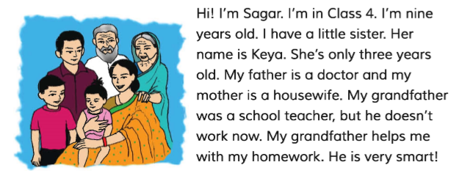
Read with me

Slide 11
1) Who is Sagor?
Ans : Sagor is a student of class four.
2) How old is Sagor?
Ans : Sagor is nine years old.

Slide 12
3) Who is Keya ?
Ans : Keya is Sagor’s sister.
3) How old is she?
Ans : She is three years old.

Slide 13
3) What does Sagor’s father do ?
Ans : Sagor’s father is a doctor.

Slide 14
3) What does Sagor’s mother do ?
Ans : Sagor’s mother is a housewife

Slide 15
4) Who helps Sagor to do his home work?
Ans: Sagor’s grandfather helps him to do his home work.

